Slide 1
FILM Techniques
Adapted from
Dirks, T. (2012) AMC Film Site. Film Glossary. http://www.filmsite.org/filmterms7.html

Slide 2
Framing
Positioning of an object in a shot.
A shot is an image that is on-screen until it is replaced by another image.

Slide 3
ESTABLISHING SHOT
usually a long (wide-angle or full) shot at the beginning of a scene (or a sequence) that is intended to show things from a distance (often an aerial shot), and to inform the audience with an overview in order to help identify and orient the locale

Slide 4
Long Shot
Object on the screen appears small or appears to be seen from some distance away.
Message: scale or emotional “distance”

Slide 5
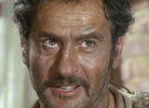
Close-up
The object or subject takes up 80%
Deprives viewer of overall context
Directs attention, emphasis on what the director intends viewer to see

Slide 6
Medium Shot
Between long and close shot
Most common and natural
Often used in TV
More comfortable

Slide 7
Focus
Different types of focus communicate different messages to an audience.

Slide 8
Soft Focus
Object or subject is ever-so-slightly out of focus
Romantic mood or mysterious

Slide 9
Rack Focus
Begins with focus on something in background of the shot, but then shifts to focus on something in the foreground
Shows changing power or emphasis in a scene
Can be a powerful way of combining close-up and languid pace of a continuous take

Slide 10
Deep Focus
All objects in focus all at once
Most realistic type of focus
Think TV

Slide 11
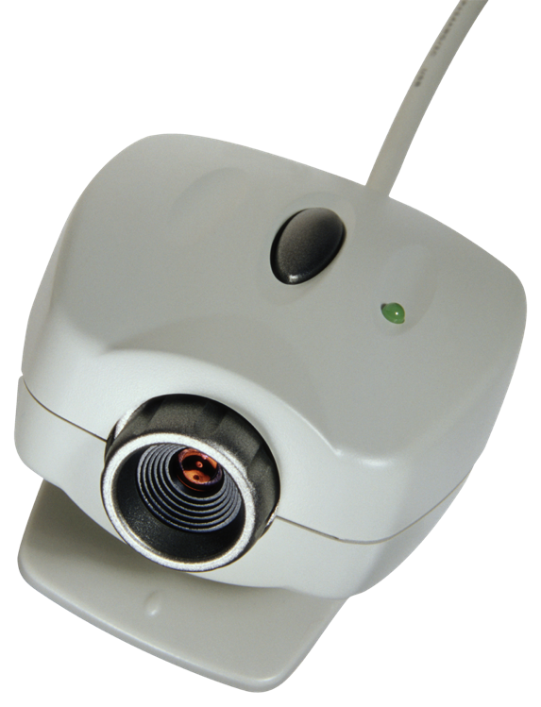
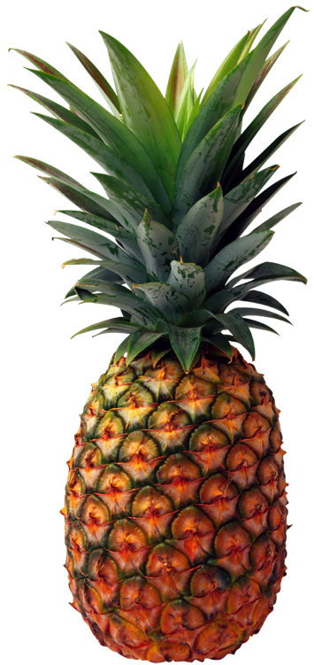
Angles
Where the camera is placed related to the subject

Slide 12
Low Angle
Camera is positioned below looking up at the subject
Size and strength can be exaggerated using this angle

Slide 13
High Angle
Camera is positioned above the subject
Weakness and powerlessness exaggerated in this type of shot
John Hurt as unimportant bureaucrat in “1984”

Slide 14
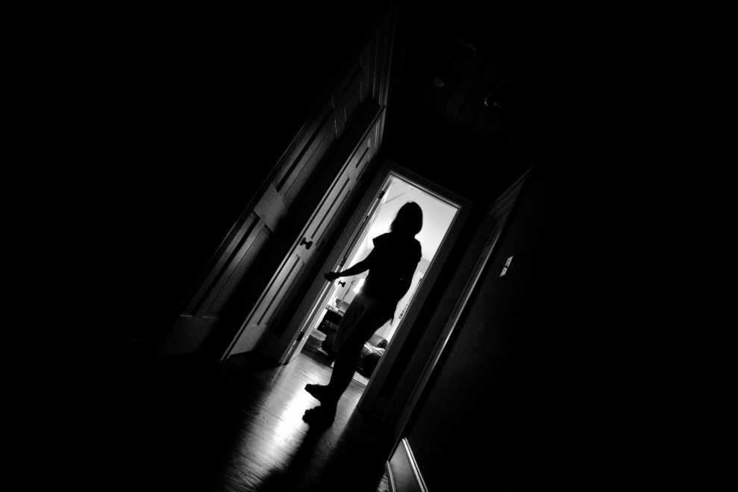
Dutch Angle
The camera tilts slightly, causing this image to appear slightly off-kilter.
Creates tension or peculiarity in an otherwise normal situation.

Slide 15
Camera Movement
Four primary types of camera movement

Slide 16
Pan
Camera pivots along a horizontal axis to follow a subject or cover space

Slide 17
Tilt
Camera moves on a vertical axis
Classic man/woman shot
Also shows size, strength, power

Slide 18
Zoom
Focal length of the lens changes
Makes object appear to move closer or further away
Directs attention to a detail

Slide 19
Tracking Shots
Only true camera movement
Unique to film
Sensation of moving through the scene
https://www.youtube.com/watch?v=s_HuFuKiq8U

Slide 20
Lighting
Principal source of light is called the “key light”
Other lights balance, shade, and soften the key light
There are five principle lighting terms

Slide 21
Low Key Lighting
Characterized by shadows, darkness, and patches of bright key light
Can create different moods: suspicion, danger, mystery

Slide 22
High Key Lighting
Brightness, openness, lack of shadows
Little contrast between light and dark
Allows scene to be seen without misunderstanding or threat

Slide 23
Neutral Lighting
Lighting is even and balanced throughout a shot
TV shows are often shot in neutral light, medium shots, with eye-level angles

Slide 24
Bottom/Side Lighting
Subject illuminated from a bottom or side angle
What effect does this achieve?

Slide 25
Front Lighting
Light is very direct on a subject
Creates a halo effect
Indicates honesty, openness, or innocence

Slide 26
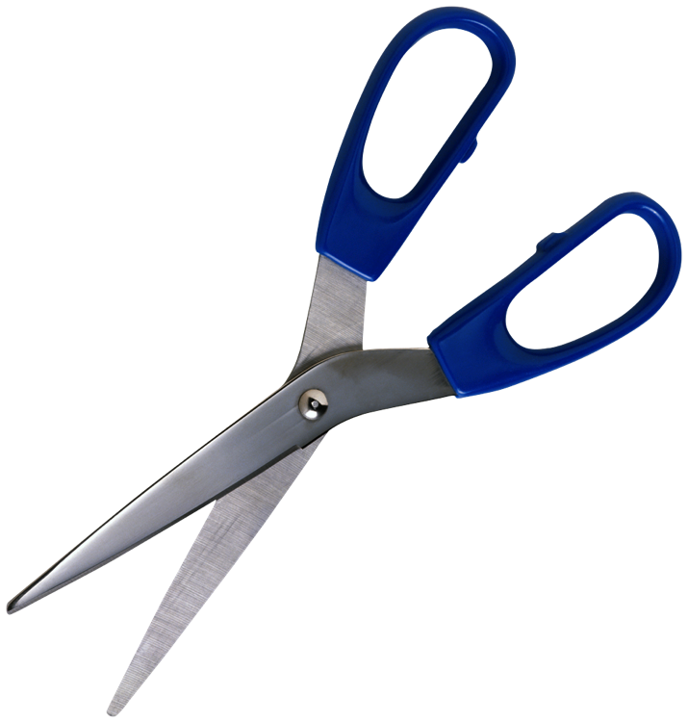
Editing
The method the director uses to move from one shot to another
Most common type is called a cut

Slide 27
CUT
an abrupt or sudden change or jump in camera angle, location, placement, or time, from one shot to another; consists of a transition from one scene to another (a visual cut) or from one soundtrack to another (a sound cut);

Slide 28
Cross cutting
Editing technique of alternating, interweaving, or interspersing two locations
Suggests parallel action (that takes place simultaneously)
used to dramatically build tension and suspense in chase scenes, or to compare two different scenes

Slide 29
Fade
Screen image slowly fades away until it is entirely black
Directors like to use this to denote the end of the scene

Slide 31
The Dissolve
Slowly begins to fade, but as one scene goes out, another image fades in

Slide 33
The Crosscut
Also called parallel editing
Allows director to show different events happening in different places but occurring simultaneously
Think about the TV show 24 or the baptism scene from The Godfather

Slide 34
Flashback or Flash-Forward
Edits that move drastically forward or back in time

Slide 35
The Eye-Line Match
Also called point of view shots
Series begins with a shot of a person looking at something
Then cuts to what they are looking at
Returns to person to show his or her reaction

Slide 36
Test
Watch video and try to recognize at least 3

Slide 37
Sound
Includes dialog, music, sound effects
Also important are pitch, timbre, direction, location (on- or off-screen)
Three main categories of sound
Creates irony, suspense, foreshadowing

Slide 38
Diagetic
Any sound that could logically be heard by a character within the movie environment
Characters could have heard the sound the audience hears

Slide 39
Nondiagetic
Any sound that cannot be heard logically by the characters in the film
Sound is intended only for the audience
Themes, incidental music, voice-over/narration

Slide 40
Internal Diagetic Sound
Sound that can be heard by only one character

Slide 41
CROWD SHOT
a shot or image of a large group of people (often extras) in a film
Often done in CGI to save money

Slide 42
CUTAWAY SHOT
a brief shot that momentarily interrupts a continuously-filmed action, by briefly inserting another related action, object, or person (sometimes not part of the principal scene or main action), followed by a cutback to the original shot
often filmed from the POV of the character and used to break up a sequence (battle scene cuts to Lucy)

Slide 43
Directing the eye
in cinematographic terms, using light and dark lighting and frame composition to emphasize what is important

Slide 44
DISOLVE
a transitional editing technique between two sequences, shots or scenes, in which the visible image of one shot or scene is gradually replaced, superimposed or blended (by an overlapping fade out or fade in and dissolve) with the image from another shot or scene (end of Across the Universe dissolves from roof to psychedelic credits)
often used to suggest the passage of time and to transform one scene to the next; lap dissolve is shorthand for 'over'lap dissolve

