Slide 1
Genres & technical
Name some EARLY genres
What are the limitations of silent films?
How does it change the way they tell the story?

Slide 2
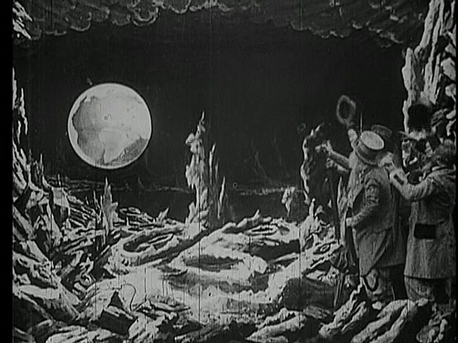
Fantasy
http://www.youtube.com/results?search_query=a+trip+to+the+moon+1902+full+movie&oq=a+trip+to&gs_l=youtube.1.1.0l10.14269.71761.0.74041.18.13.4.1.1.0.151.1380.4j9.13.0...0.0...1ac.1.11.youtube.uNNEYALe7F8
Georges Méliès (1902)
Subject of modern film “Hugo”

Slide 3
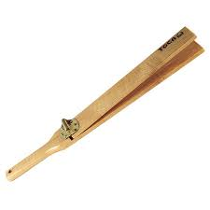
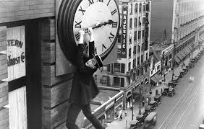
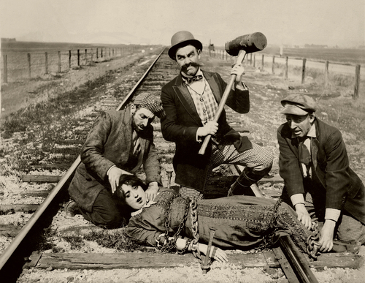
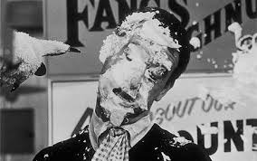
Slap stick
Comedy with the emphasis on fast physical action, farcical situations,
and obvious PHYSICAL humour
http://www.youtube.com/watch?v=a8jphxpi1ro

Slide 4
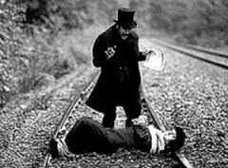
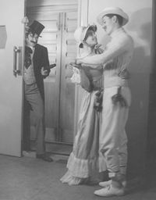
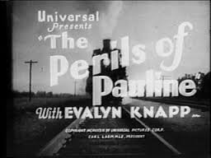
Melodrama
sensationalized dramatic work characterized by the use of stereotyped characters, exaggerated emotions, simplistic morality, and black & white conflict
http://www.youtube.com/watch?v=84TwFWtRueQ

Slide 5
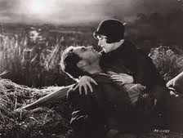
Romance
focus on passion focus on passion, emotion, and the affectionate romantic involvement of the main characters and the journey that their genuinely strong, true and pure romantic love takes them through dating, courtship to marriage
http://www.youtube.com/watch?v=7OAlbfZRCvY

Slide 6
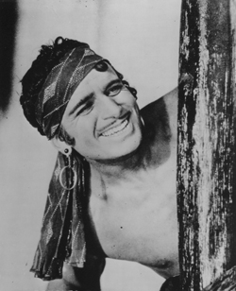
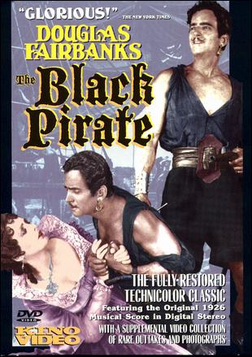
Action
http://www.youtube.com/watch?v=T9P3XXvleo4
Daring Do and feats of strength and bravery with thin plot
Most actors did own stunts
Often based on classic stories

Slide 7
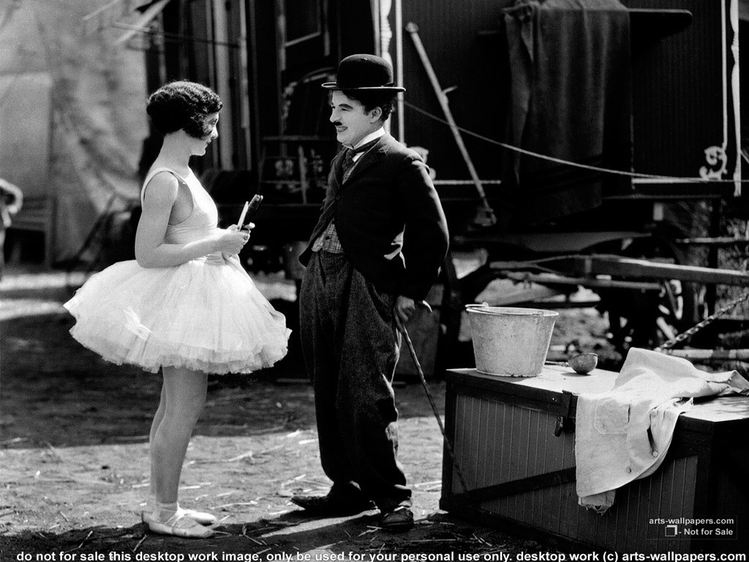
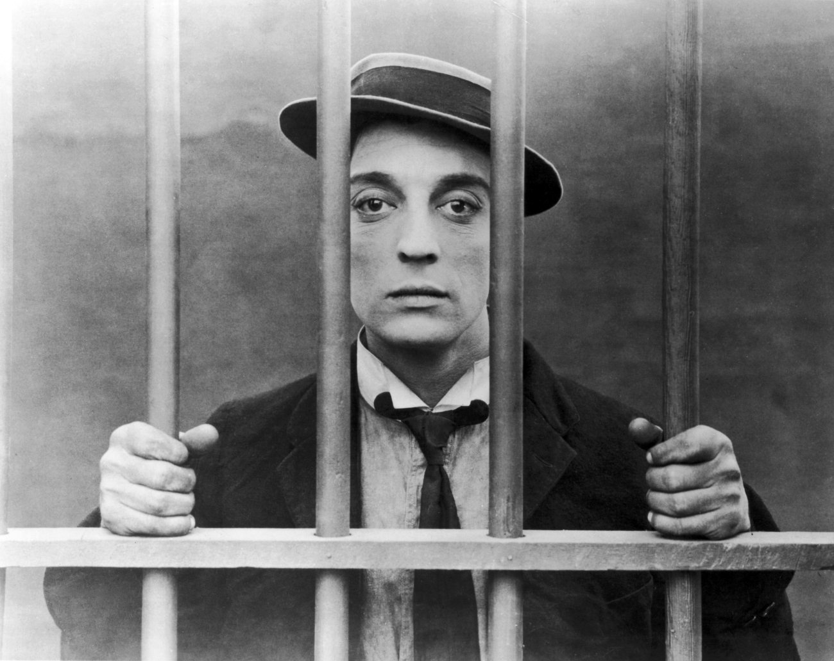
Comedy
http://www.youtube.com/watch?v=nt-_DXC-aik
Innocent, or victimized overcome and get the girl
Charlie Chaplin
Buster Keaton

Slide 8
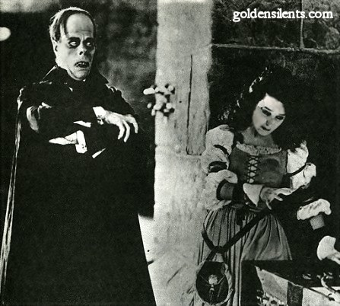
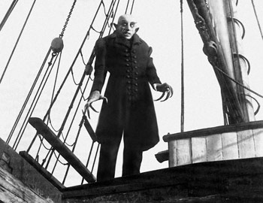
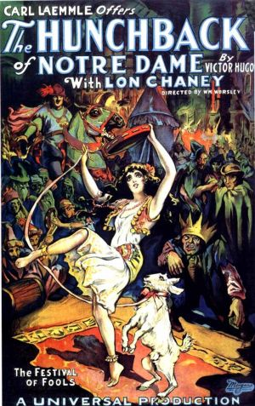
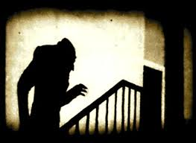
Horror
Melodramatic
Based on Classic horror books
https://www.youtube.com/watch?v=i9WUmq_CeWA

Slide 9
The Making of Hollywood (an immigrant journey)
http://www.wikihow.com/Make-a-Silent-Movie

